Slide 1
Atlantic Coast Pipeline (ACP)
Virginia Outdoors Foundation (VOF)
February 9, 2017

Slide 2
Presentation Outline
Project Overview
VOF Conversion/Diversion Process
Essentiality
Local Comprehensive Planning
Routing Alternatives Analysis
Replacement Lands

Slide 3
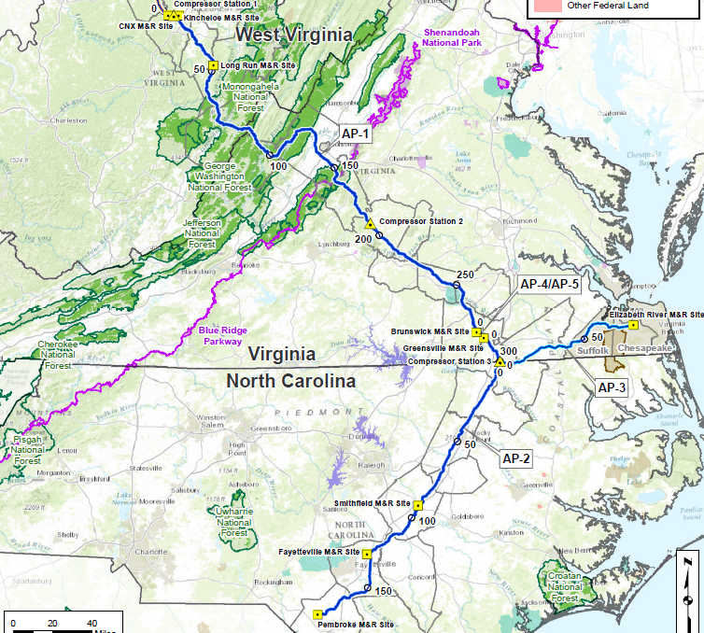

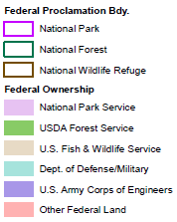

Project Overview
Virginia Power | 20%
Virginia Natural Gas | 5%
Piedmont Natural Gas | 11%
Public Service North Carolina | 7%
Duke Energy | 48%
Capacity 1.5 bcf/d
>90% Subscribed

Slide 4

Project Expected Timeline
FERC Scoping
Meetings
FERC Issued Draft Environmental
Impact Statement (DEIS)
- Federal Agency Decision Deadline
- FERC Notice to Proceed
- Construction Commences
FERC Notice of Schedule
March 2015
December 2016
Fall 2017
2015
2016
2017
2018
2019
September 2015
August 2016
Late 2019
June 2017
USFS LRMP Amendments
USFS Construction Operation & Maintenance Plan
-USFWS Section 7 (ESA) Consultation Initiated
-USFWS Drafting Biological Opinion
-US Army Corps Wetland Permitting
-Section 106 determination of effects
-Air Permit processing
-State Erosion & Sedimentation Controls
-Local Permits (Buckingham SUP approved)
Filed FERC
Application
FERC Final Environmental Impact Statement (FEIS)
ACP
In Service

Slide 5
VOF’s Conversion/Diversion Process -
Established in Virginia Code § 10.1-1704
VOF has authority to approve the applications because ACP is:
essential to the orderly development and growth of the locality;
in accordance with the official comprehensive plan for the locality in effect at the time of conversion or diversion; and
there is substituted other real property, which is:
  of at least equal fair market value,
  of greater value as permanent open-space land than the land converted or diverted, and
  of as nearly as feasible equivalent usefulness and location for use as permanent open-space land as is the land converted or diverted.

Slide 6
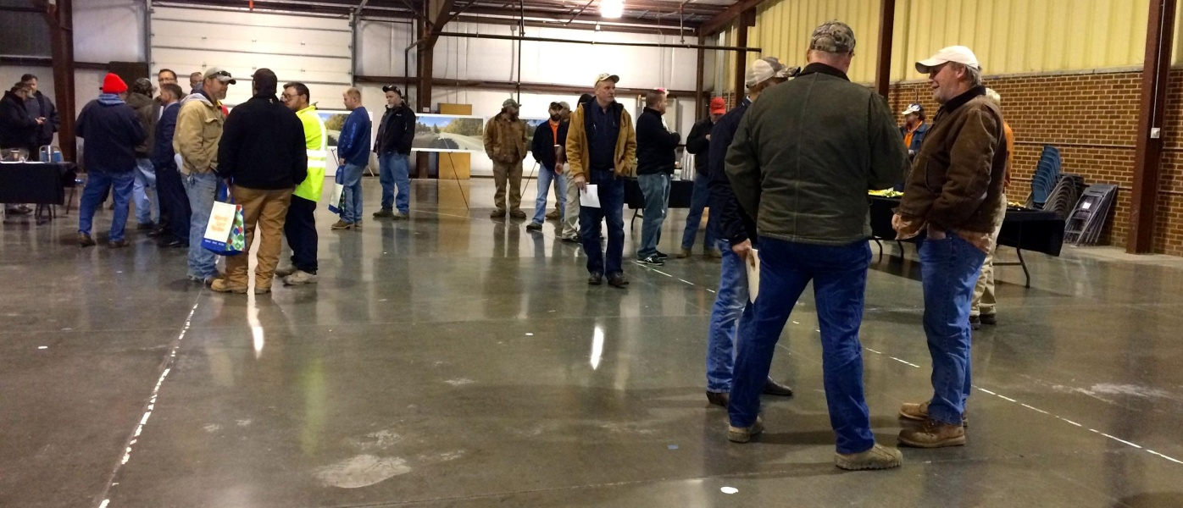
Essential:
“Essential to the Orderly Development and Growth” of the Localities
Property Tax Benefits
Employment/Vendor Opportunities
 | 2019 Construction example | 2025 Operations example | Total (2019-2025)
Augusta | $425,469 | $1,982,345 | $12,157,901
Bath | $144,581 | $673,634 | $4,131,461
Highland | $58,147 | $270,916 | $1,661,555
Nelson | $269,817 | $1,257,135 | $7,710,121
Total | $898,014 | $4,184,030 | $25,661,038
50% of craft and trade workers hired through local unions
Subcontracting, supplier and vendor opportunities
Community services
Reduced Energy Costs
Orderly Growth

Slide 7
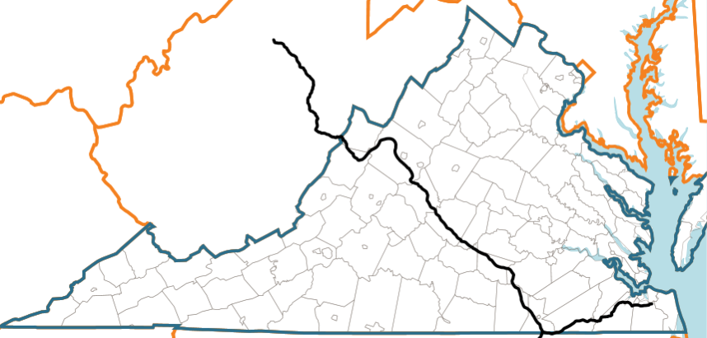
Essential:
Economic Benefits for Virginia*
Pipeline Construction
$1.4 billion
Total economic activity
8,800
Jobs supported **
$2.4 million
Average annual tax revenue
$2.5 billion
In capital expenditures
$243 million
Average annual energy cost savings
Pipeline Operation
$37.8 million
Total annual economic activity
1,300
Jobs supported **
$10.4 million
Average annual tax revenue
  *Analysis provided by ICF International, Chmura Economics & Analytics, and Dominion Resources. These estimates are subject to change because of route variations and other adjustments.
  ** A job is considered a person working full time for one year

Slide 8
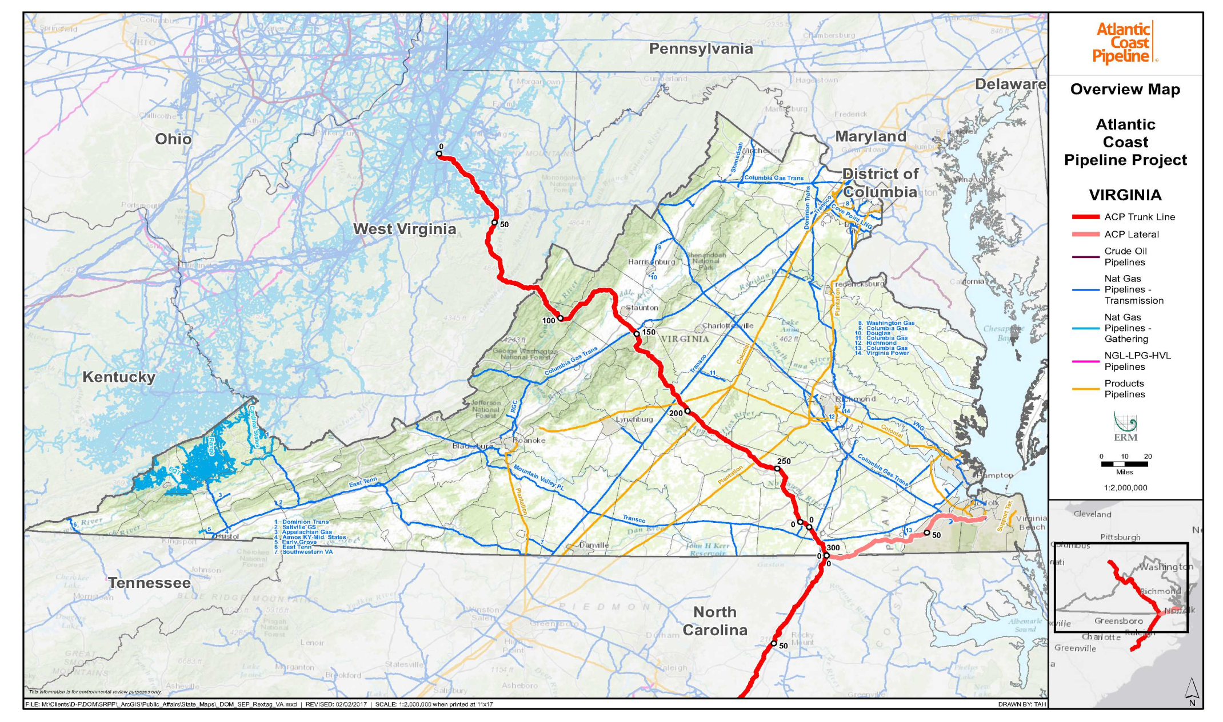
Local Planning:
“In Accordance with Local Comprehensive Plans”
No prohibition or direct conflict
Extensive planning to address locality concerns including reroutes
Consistent with specific plan provisions in each locality:
  Supports orderly infrastructure and related economic development
  Mitigation of environmental impacts, including those associated with karst, water resources, steep slopes, etc.
VOF determines consistency

Slide 9
Local Planning:
Proactive Environmental Management
Upland Erosion Control, Revegetation, and Maintenance Plan (E&S)
Wetland and Waterbody Construction and Mitigation Procedures
Karst Terrain Assessment, Construction Monitoring, and Mitigation Plan
Geohazard Analysis Program
Restoration and Rehabilitation Plan
Timber Removal Plan
Contaminated Media Plan
Spill Prevention, Control, and Countermeasures (SPCC) Plans
Invasive Plant Species Management Plan
Migratory Bird Plan
Virginia Fish Relocation Plan
Traffic and Transportation Plan

Slide 10
Local Planning:
Best in Class (BIC)
Dominion has committed to using best-in-class standards throughout construction and operation. This includes the use of efficient design techniques that go above and beyond regulatory requirements to minimize environmental impacts while providing safe and reliable construction and operations.
Pollinator Habitat and Right-of-Way Restoration
Pilot initiative to re-seed rights-of way with native grasses and flowers to attract native pollinator species.
In cooperation with experts from state and federal resource agencies to determine the best locations for establishing pollinator habitats in rights-of-way.
Steep Slope Sediment and Erosion Control
Slopes that are > 30%
Methane Emissions Reductions
Fugitive emissions reduction initiative includes equipment and procedures that significantly reduce the amount of methane released into the atmosphere.
Vent gas recovery compressor, selective catalytic reduction system ,and oxidation catalyst
Above and beyond State regulatory standards to proactively mitigate for potential erosion and sediment discharges along the right-of-way that can potentially impact environmental resources.

Slide 11
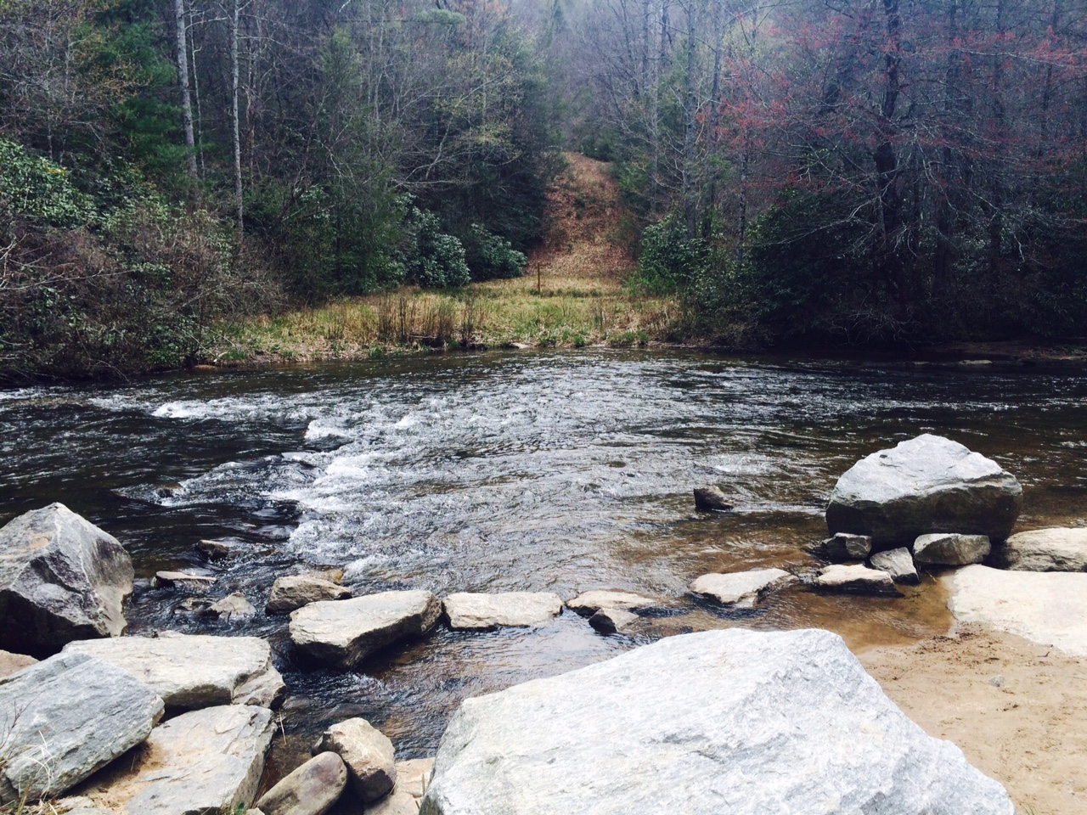
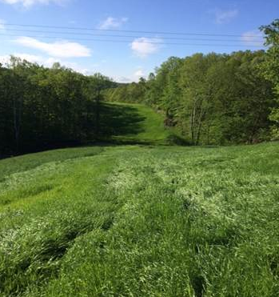
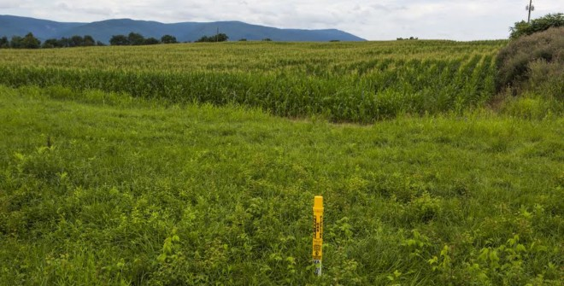
Local Planning:
Restoration and Rehabilitation
Stream Crossing
ROW Video
Greater than 50’ Forested ROW
Non-Forested ROW

Slide 12
1704 Applications
Reduction of Permanent Impacts
Easement Name | County | Previously Proposed Permanent Impacts (acres) 75-foot-width Right-of-Way | Currently Proposed Permanent Impacts (acres) 50-foot-width Right-of-Way | Currently Proposed Percentage of Easement Impacted
Teague | Highland | 9.0 | 6.07 | 0.8%
Normandy | Bath | 16.4 | 13.01 | 1.6%
Rice | Bath | 9.2 | 6.48 | 2.1%
Chandler | Bath | 1.2 | 0.80 | 1.4%
Revercomb | Bath | 11.4 | 8.72 | 1.2%
Koontz | Bath | 6.2 | 4.13 | 1.5%
Wilderness | Bath | 11.4 | 8.27 | 1.1%
Bright | Bath | 2.4 | 2.30 | 0.7%
Berry | Bath | 3.26 | 1.02 | 0.9%
 | Augusta | 0.81 | 0.5 | 0.4%
Saunders | Nelson | 4.3 | 3.28 | 0.9%
Total |  | 73.88 | 54.59 | 1.2%

Slide 13
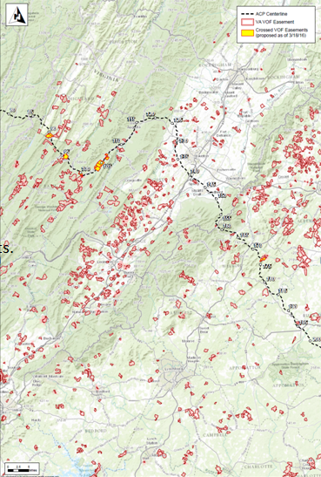
Extensive Alternatives Analysis
Conducted extensive alternative analysis to avoid impacts to VOF easements.
Through the rerouting process, ACP has successfully avoided 25 easements and is working to minimize impacts to those proposed for crossing.
Avoids U.S. Forest Service critical habitat areas, while meeting project customers’ delivery points.

Slide 14
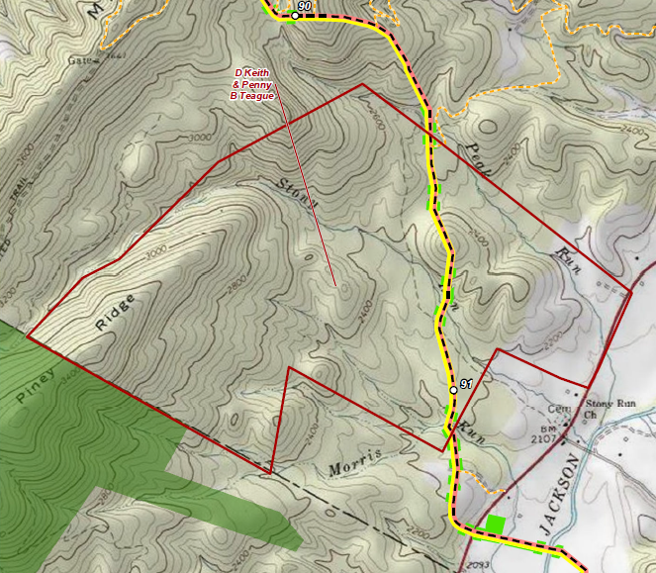
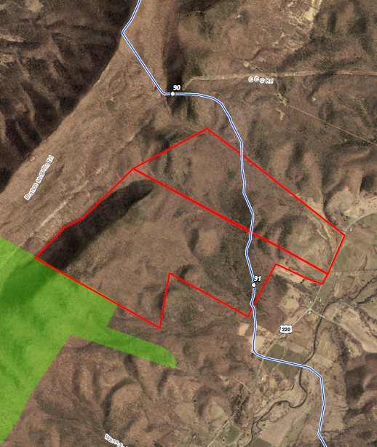
Teague Easement – Highland County

Slide 15
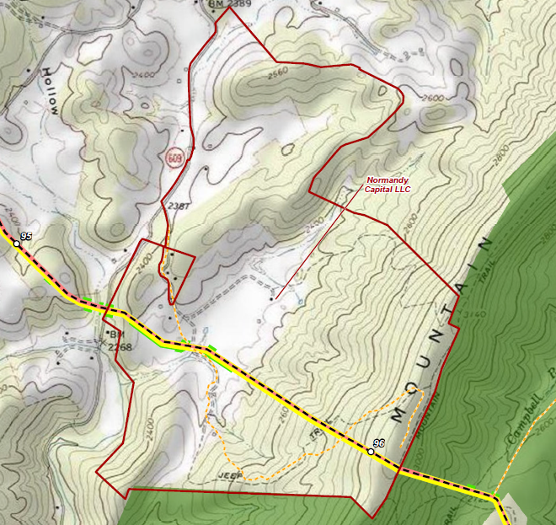
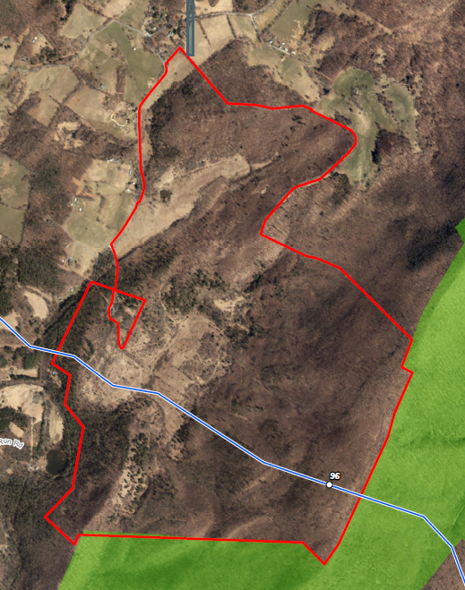
Normandy Easement – Bath County

Slide 16
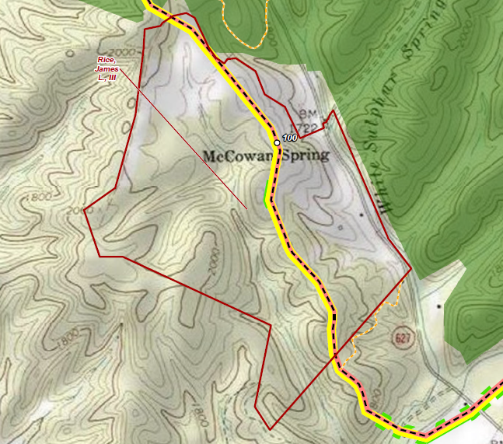
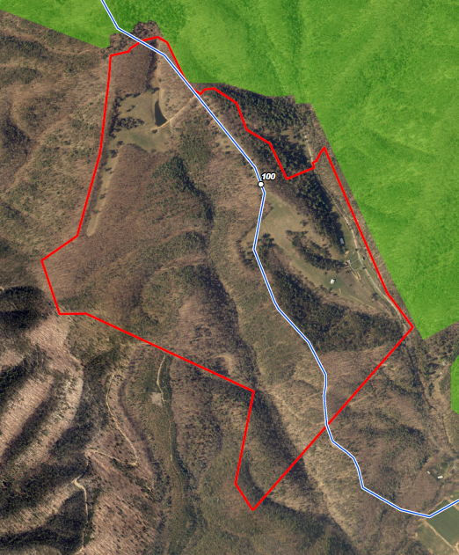
Rice Easement – Bath County

Slide 17
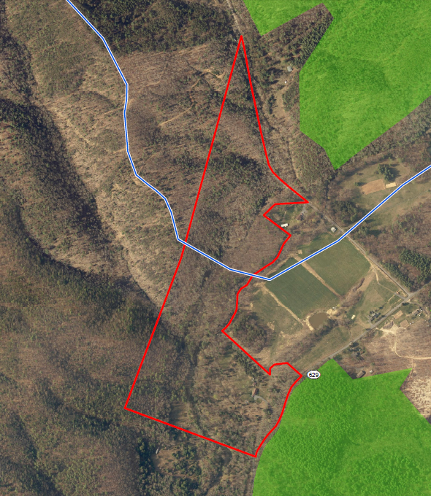
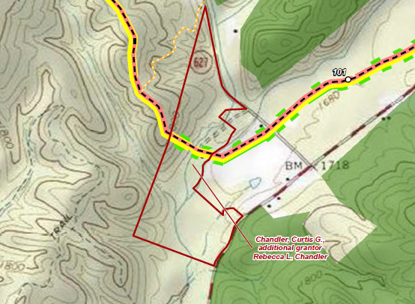
Chandler Easement – Bath County

Slide 18
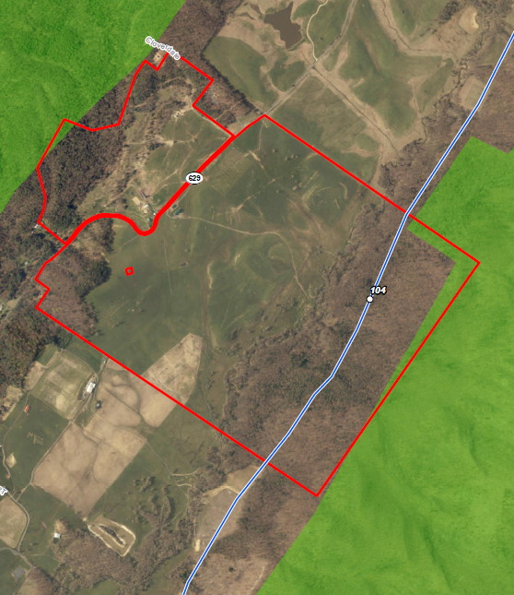
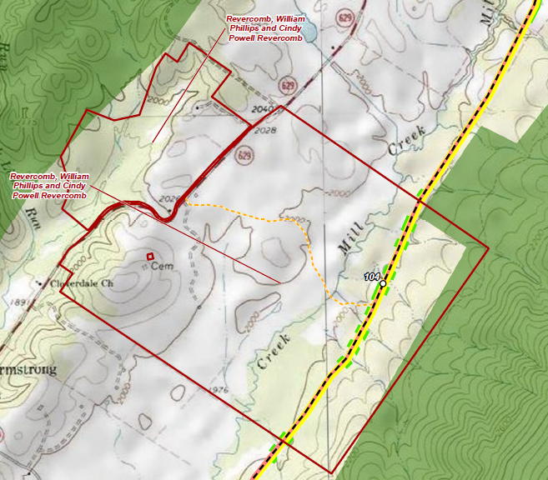
Revercomb Easement – Bath County

Slide 19
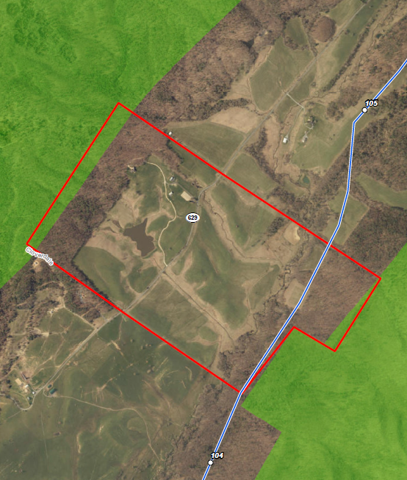
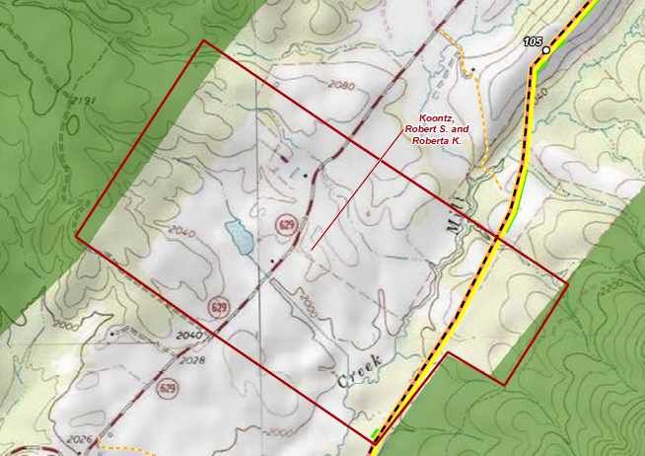
Koontz Easement – Bath County

Slide 20
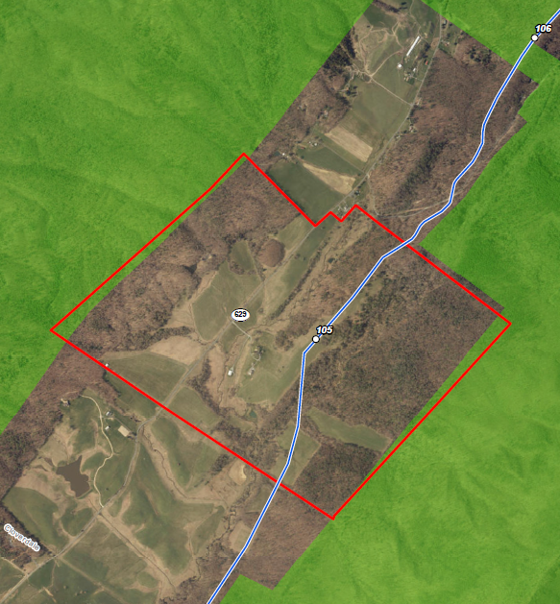
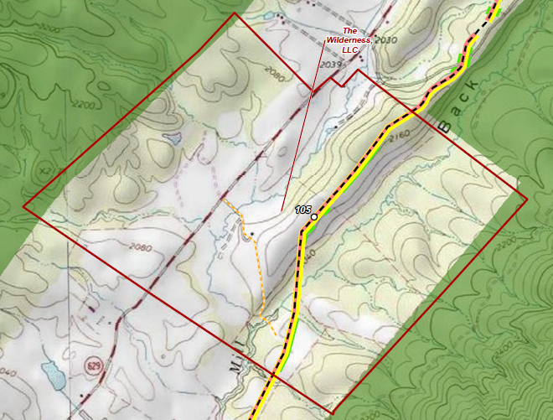
Wilderness Easement – Bath County

Slide 21
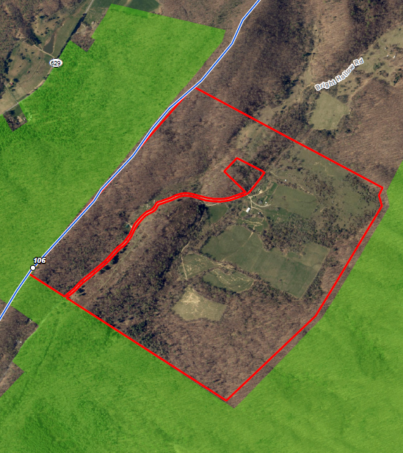
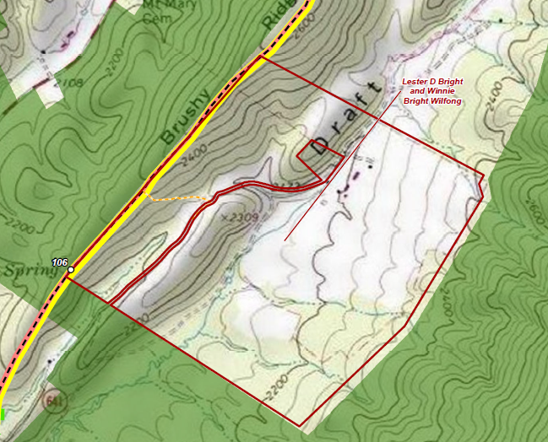
Bright Easement – Bath County

Slide 22
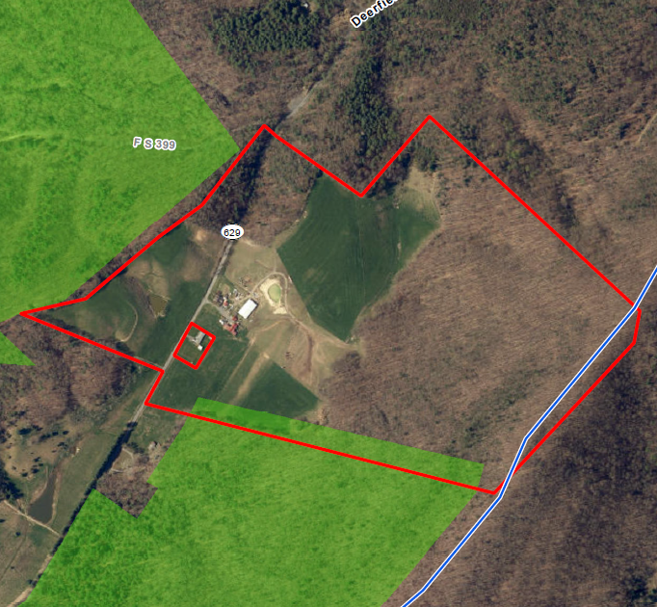
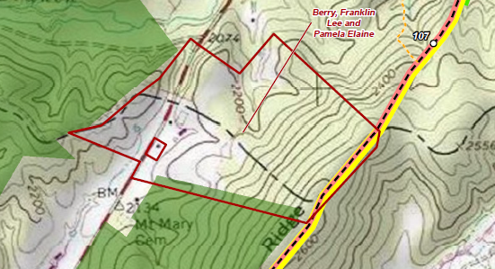
Berry Easement – Augusta & Bath

Slide 23
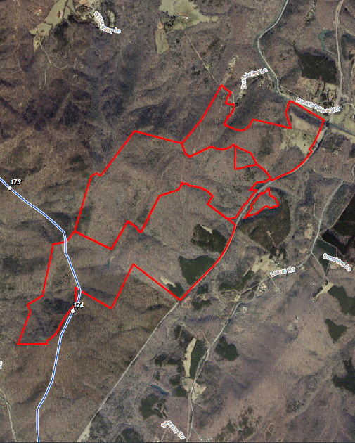
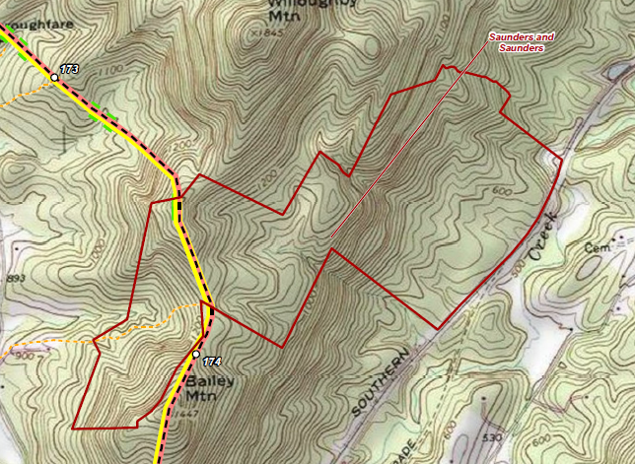
Saunders Easement – Nelson County

Slide 24
VOF Replacement Lands
Hayfields Farm and Rockfish River
  Higher fair market value;
  High value as permanent open-space land than the land converted or diverted; and
  Equivalent usefulness and location for use as permanent open-space land.

Slide 25
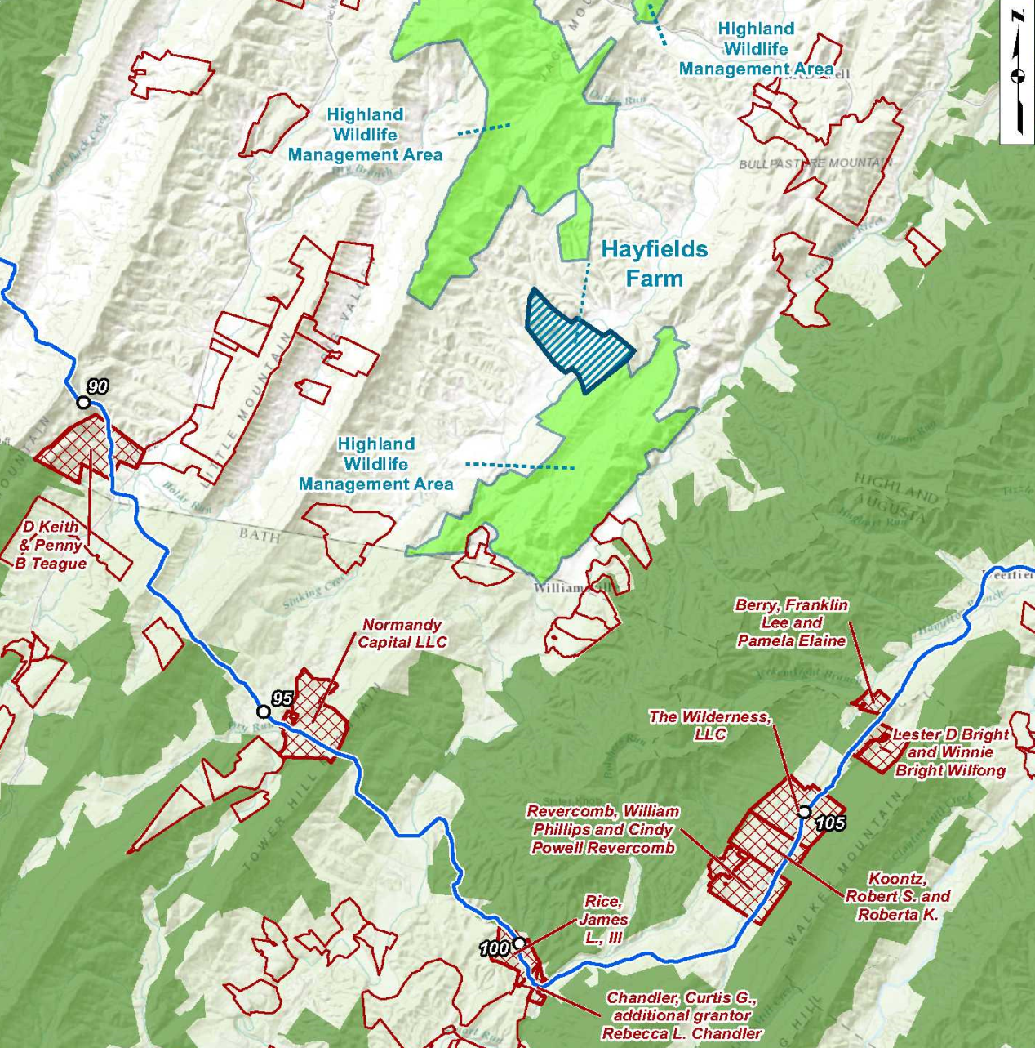
VOF Replacement Land – Hayfields Farm Parcel

Slide 26
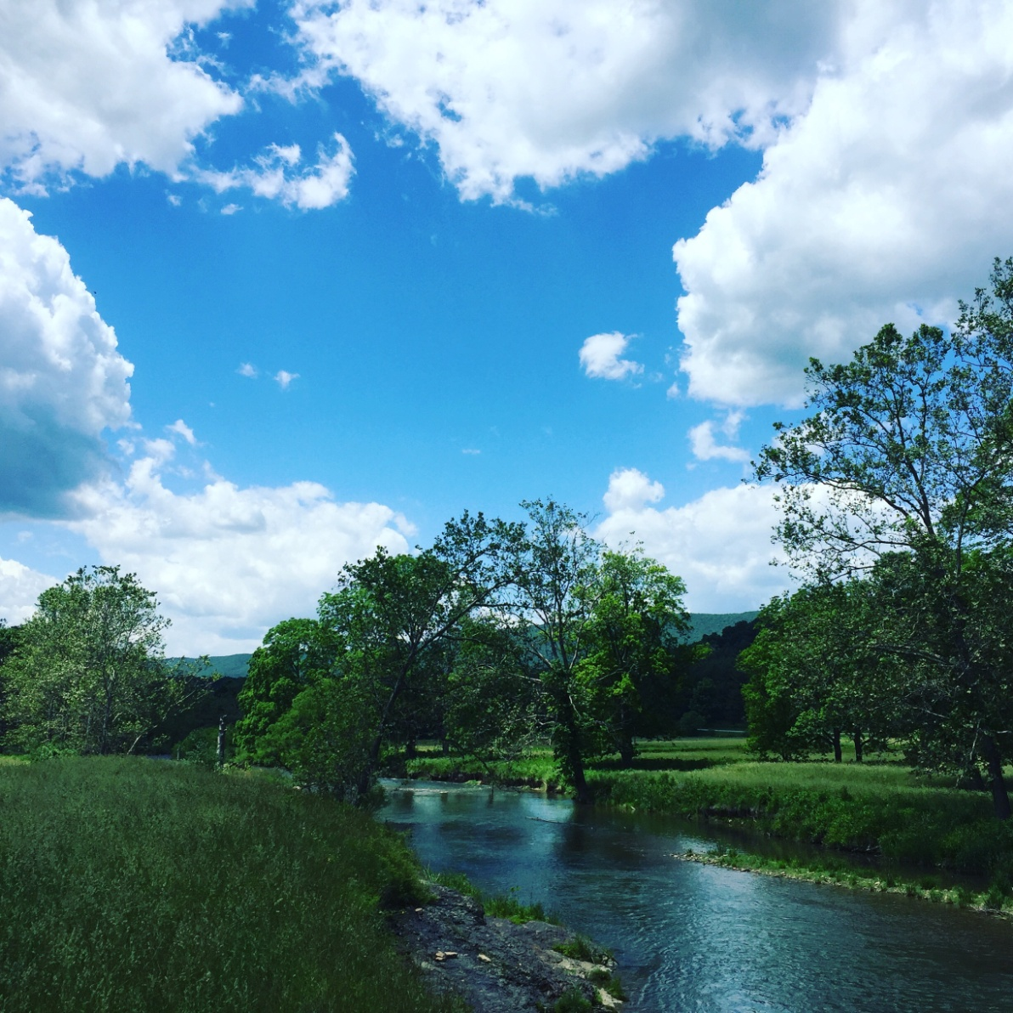
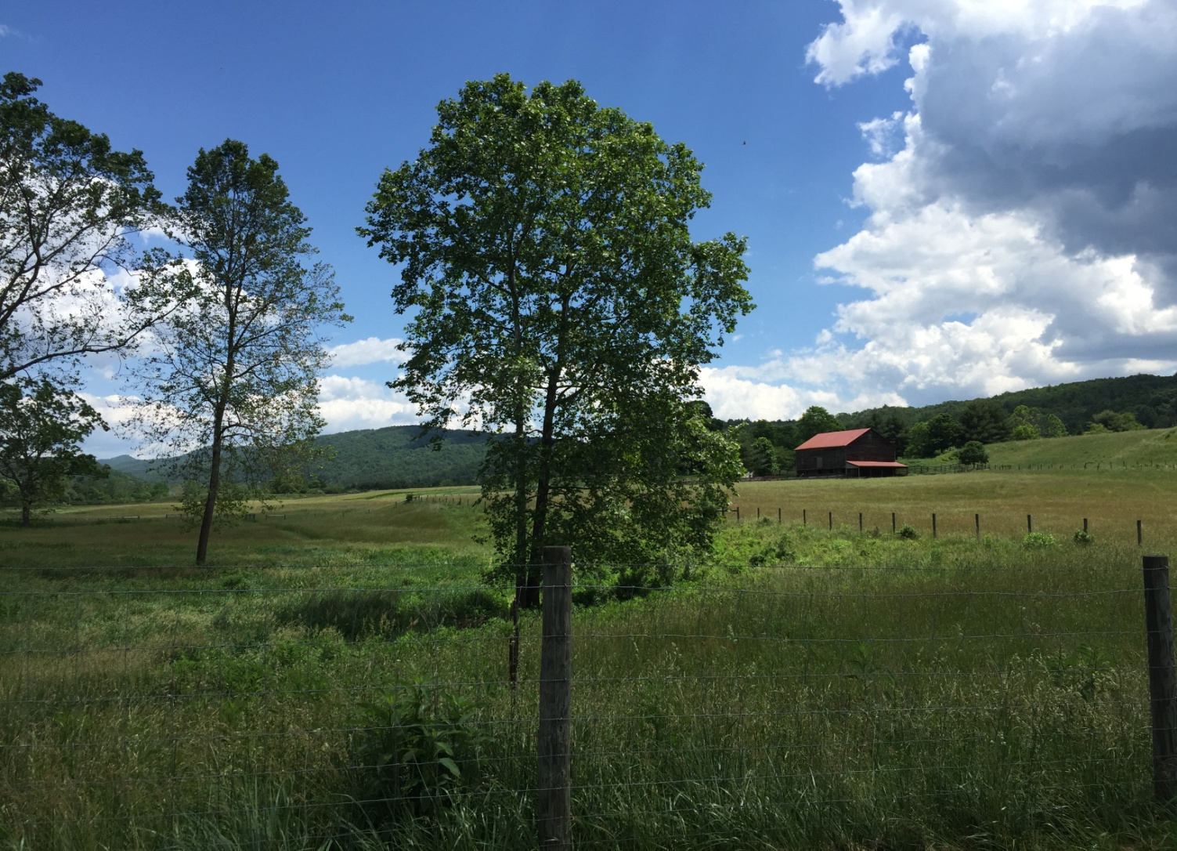
VOF Replacement Land – Hayfields Farm Parcel

Slide 27
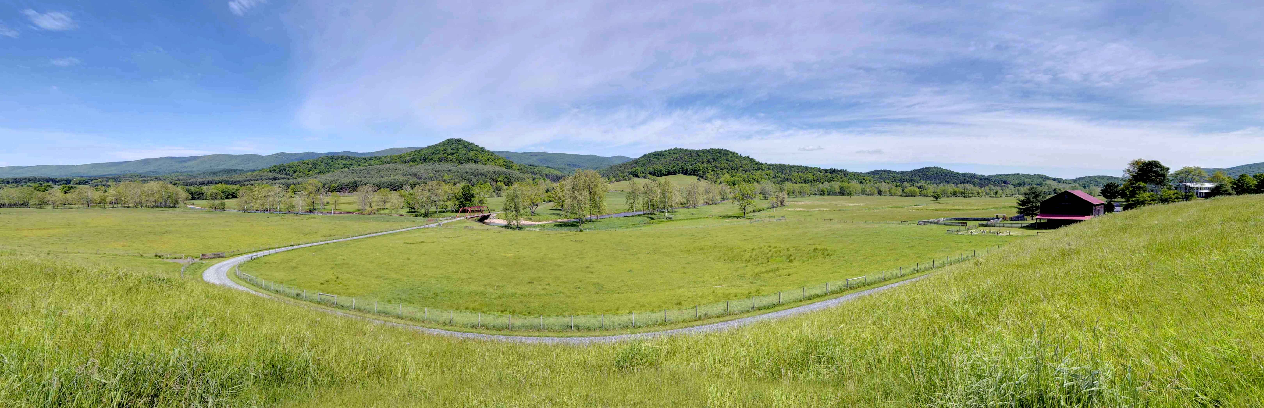
VOF Replacement Land – Hayfields Farm Parcel

Slide 28
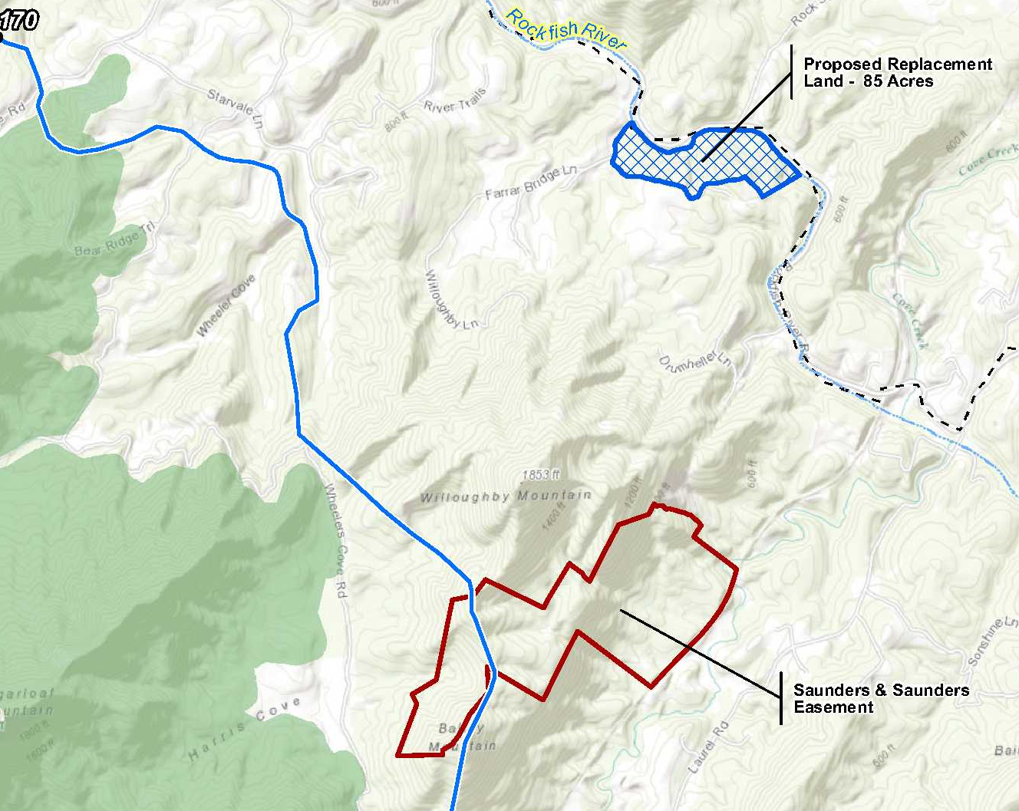
VOF Replacement Land – Rockfish River Parcel

Slide 29
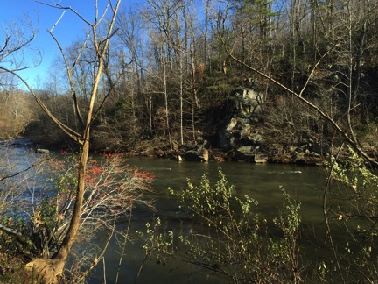
VOF Replacement Land – Rockfish River Parcel

Slide 30
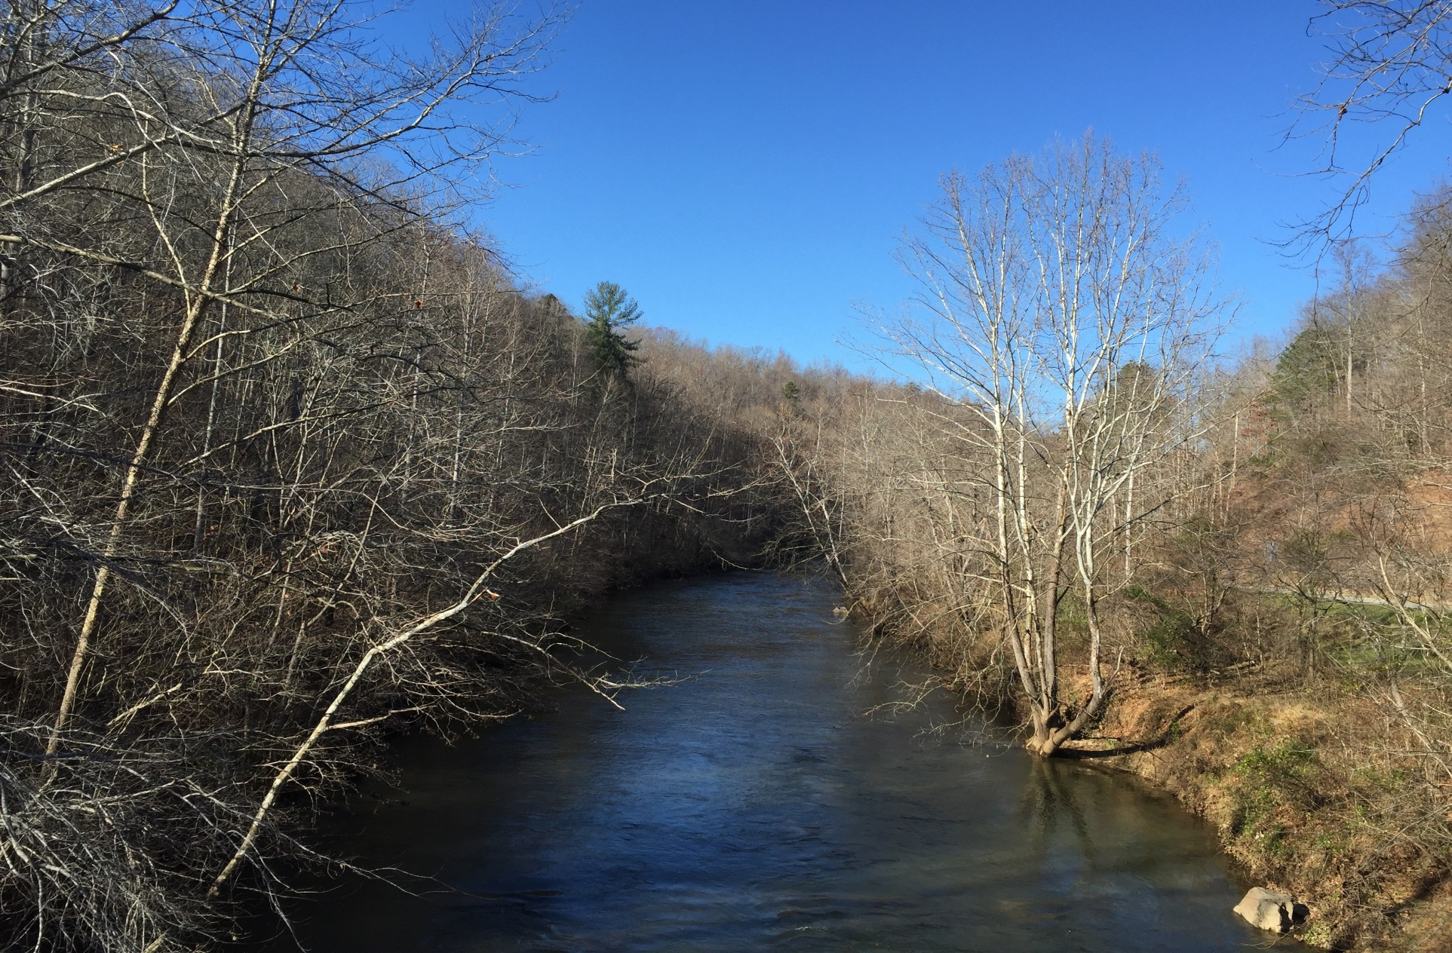
VOF Replacement Land – Rockfish River Parcel

Slide 31
Conclusion
“Essential” to the localities
“In accordance with” local plans
Appropriate replacement lands
Extensive past, on-going and future efforts to preserve conservation values
Questions?

